Slide 1
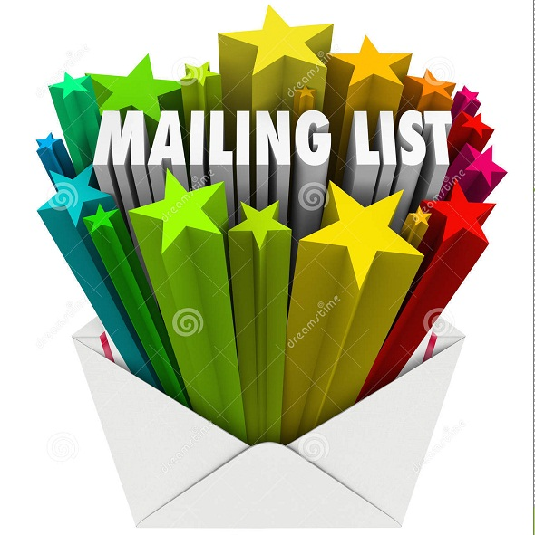
B2B MAILING LISTS – B2b DataQuest

Slide 2
INTRODUCTION
Have you ever thought as to why there are so many email list providers in the market and why do they make this as their profession? The potential of their product often gets masked under just the mere volume or price of their products. A potential email list obtained by any business house from a list provider brings him many steps closer to his potential customer. His efforts in reaching the right consumer base are made unbelievably simple once he obtains the right B2B mailing list. Let’s do well further into the importance of obtaining a good mailing list.

Slide 3
WHY B2B EMAIL LISTS?
Time Saving
What might take you months and years to build from various sources is readily available from authorised and quality B2B Email list providers. The fact that the list are always updated and accurate benefits the businesses immensely and saves the time that you might need to even start making a list for yourself.
Improves Sales Revenue
An updated and precise b2b email list will help businesses take their product or services to the right target audience. This has manifold advantages as it helps in effective reach and thereby improved brand visibility, brand awareness and in turn improves market value and sales.

Slide 4
IMPORTANCE OF B2B MAILING LISTS
Business Growth
As we have been elaborating that purchasing an effective email list leads effective sales and thereby revenue growth, it needs no special mention that this will eventually lead to business growth. Purchasing a B2B Email List will result in improving the growth of business on a regular basis. Therefore, growing your email lists from reliable and reputed sources will lead to steady business growth.
Easy Communication channel
Purchasing an effective Email list will help in easy integration and communication with the customers. The effectiveness in your business communication with clients improves tremendously and this leads to creating a stronger bond with the customer.

Slide 5
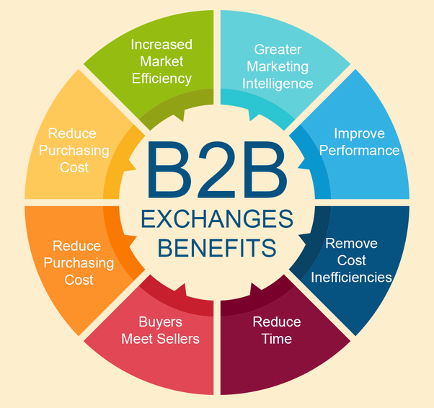
Benefits of B2b Mailing Lists
So knowing your prospective customer and converting them to permanent clientele is made possible with tailor made B2B email Lists.

Slide 6
BENEFITS OF PURCHASING EMAIL LISTS
Way to find Target Market
Purchasing an effective B2B Email List from a reliable source is a quick way to get access to thousands of right target customers and reach out your products/services to them.
Cost Effective
For the same reason as purchasing B2B Email Lists would be less time consuming also makes it comparably more economical for your business as you would be spending lesser for the manpower involved to collect the same.
High ROI
Concentrating all your business efforts and channelizing your communication to the right target audience leads to business growth with high ROI.

Slide 7
CONCLUSION
Email lists that are obtained from reputed email list providers is clean, bounce free email that is updated to fill in the latest names in the industry. This assures 100% deliverability and thereby gives maximum returns too.

